Slide 1

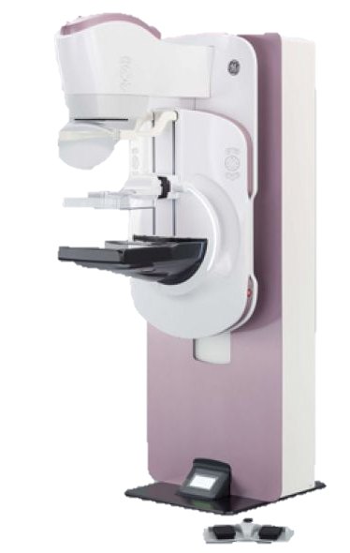
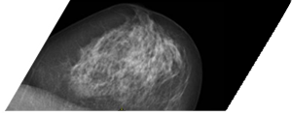
X-ray breast imaging
Worldwide breast cancer accounts for 25.2% of all female cancers and 16% of cancer deaths in adult women
2D mammography: the standard for population-based breast cancer screening
(Fibro)glandular tissue
Adipose tissue

Slide 2
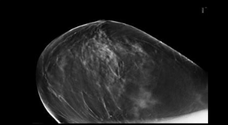
X-ray breast imaging
Worldwide breast cancer accounts for 25.2% of all female cancers and 16% of cancer deaths in adult women
TOWARDS…
3D Digital breast tomosynthesis: Today investigational for screening
z
z
…
…
Reconstruction

Slide 3

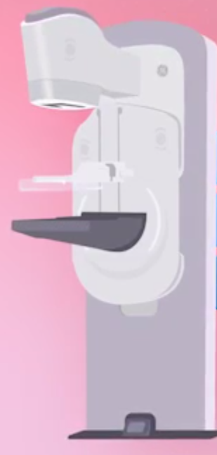

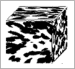
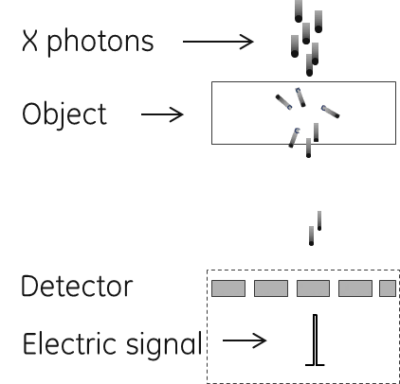
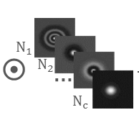
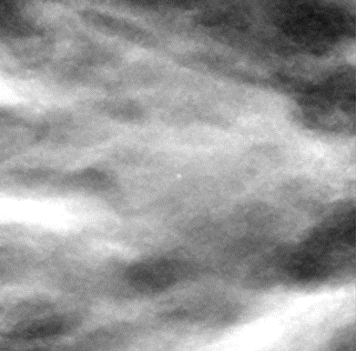
Virtual clinical trials (VCT)
Clinical Trials
Virtual Clinical Trials (VCT)
Patient
Imaging system
Radiologist
Digital breasts
Digital imaging system
Model observer
Clinical protocol
Virtual clinical protocol
FASTER
COST SAVING
MORE
ACCURATE
Image acquisition
Image review
Ground truth
No patient recruitment
No radiologists involved
No patient monitoring
No legal contracts
Full knowledge of breast model & pathology
Notes:
For performance assessment of breast imaging technologies, clinical trials are essential. But they can be burdensome. Today many groups are investigating the potential of virtual clinical trials, or VCT, to offer a more efficient and less costly alternative.
In VCT,
Patients are replaced by physical or simulated phantoms and lesions.
The images are acquired using physical machine or an x-ray simulator modelling the physics.
Images are reviewed by radiologists or by model observers, which are mathematical models that aim to replace radiologists in specific clinical tasks, such as lesion detection.
In VCT, the ground truth is stored in the computer.

Slide 4
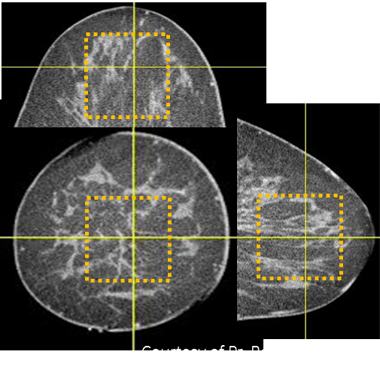
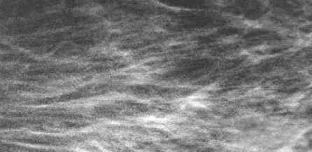
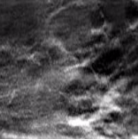
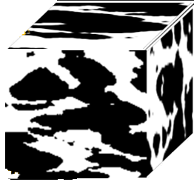
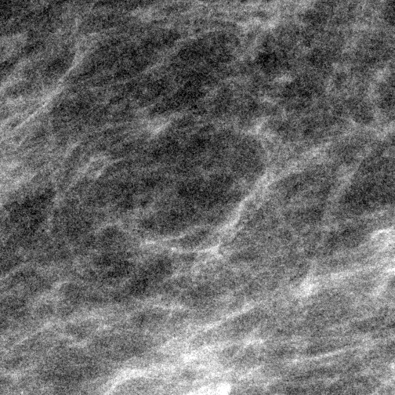
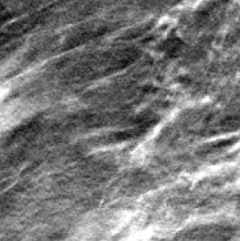
Input: clinical breast CT data
Re-projection of segmented breast CT (bCT) data
Projections
Recon. slices
DBT projection simulation
5 x 5 x 5cm³
Extraction & Segmentation
Clinical
Idea: model tissue morphology & distribution as in bCT
Medium scale
Intra-glandular adipose compartments → Random ellipsoids
Small scale
Adipose compartments boundary irregularity → Voronoi diagram
Notes:
To develop such a model, we use a data base of clinical breast CT reconstructed volumes, from John Boone, UCDavis as input. As a first analysis, we extracted cubes inside the breast CT volumes and then segmented the fibroglandular breast tissue from them. This resulted in binary volumes, shown here, depicting the fibroglandular and adipose breast tissue.
Next, we reprojected the binary volumes using an x-ray simulator. This allowed us to obtain simulated DBT projection images, as shown here. Finally, a 3D reconstruction algorithm was applied on the DBT projection images. This allowed us to obtain DBT reconstructed slices. One of them is illustrated here.
For a visual comparison, below we have images extracted from clinical DBT projection and reconstructed images. We observe that the segmented breast CT data sets allows to simulate realistic DBT projections & reconstructed slices.
This analysis gives us the idea of modeling the tissue morphology & distribution as seen in breast CT data. We focus on the medium and the small-scale breast tissues. For the medium-scale intra-gland adipose compartments, we observed that they can be approximated by system of random ellipsoids. We also observed small-scale adipose compartment boundary irregularities. To model this small-scale aspect, we will use Voronoi diagrams.

Slide 5

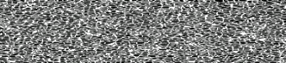
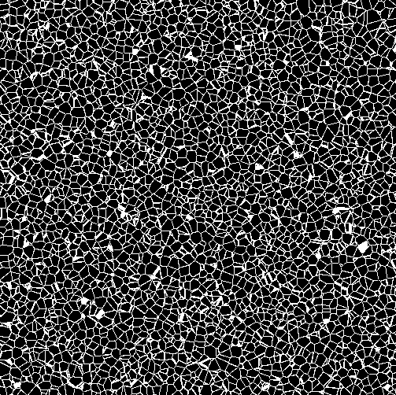
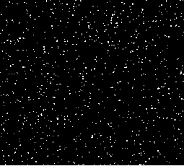
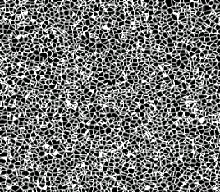
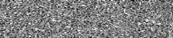






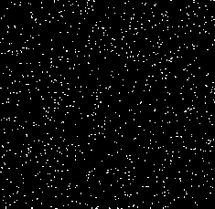

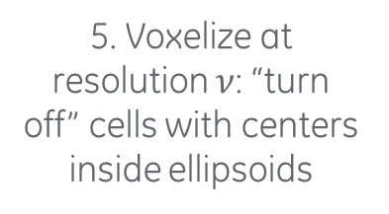
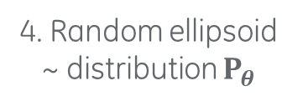
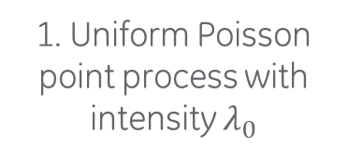
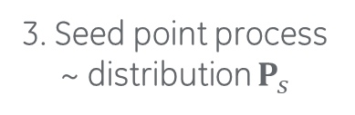
3D breast texture sampling algorithm
Small scale
1. Uniform Poisson point process with intensity $λ_{0}$
2. Voronoi diagram using points from step 1.
Medium scale
5. Voxelize at resolution $ν$: “turn off” cells with centers inside ellipsoids
Nipple
3. Seed point process ~ distribution $P_{s}$
4. Random ellipsoid ~ distribution $P_{θ}$
Notes:
Now let me dive into the algorithm to sample from our new texture model.
We start with the small scale
First sample points from a uniform poisson point process, from which we create a Voronoi diagram with very small cells
Then we deal with medium scale
Independently from the first two steps, we sample points from a seed point process with distribution P_s.
At each seed point, we place a random ellipsoid oriented towards the nipple, with distribution P_theta
The final step is the voxelization at resolution nu
This is done by check each small Voronoi cell in step 2. If its center falls inside of one of the ellipsoids, we assign 0 to the entire cell; otherwise, we assign 1 to the entire cell..

Slide 6

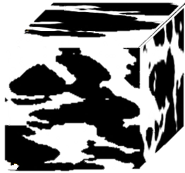
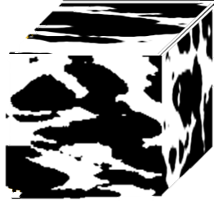
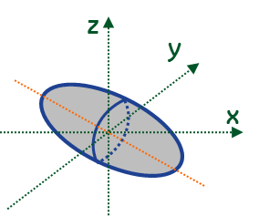
Statistical inference of model parameters
GOAL
Objectively infer medium scale model parameters from segmented clinical bCT volumes of interest
Medium scale parameters
Seed point process
Ellipsoid parameters
Statistical inference
Clinical segmented bCT volumes of interests (VOIs) w/ diff. density
Notes:
Our next study consists of formally infer the texture model parameters from a set of segmented clinical breast CT data using statistical inference.
Particularly, we focus on the medium scale model parameters. That is, the distribution for the seed point process, and the distribution for the ellipsoid parameters.

Slide 7



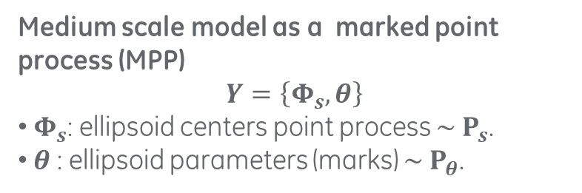
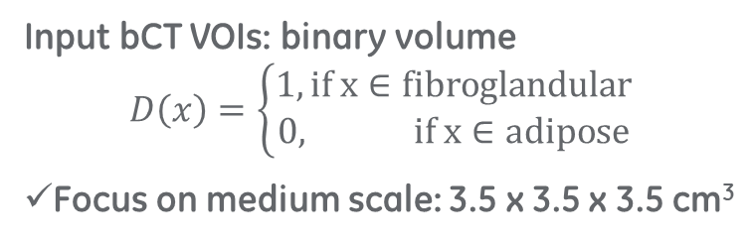
Problem statement
Medium scale model as a marked point process (MPP)
$$Y=\left\{Φ_{s},θ\right\}$$
$Φ_{s}$: ellipsoid centers point process $\sim P_{s}$.
$θ$: ellipsoid parameters (marks) $\sim P_{θ}$.
Nipple
Input bCT VOIs: binary volume
$$D\left(x\right)=\left\{\begin{aligned}1, if x∈fibroglandular \\ 0, if x∈adipose\end{aligned}\right.$$
Focus on medium scale: 3.5 x 3.5 x 3.5 cm³
Inference is ill-posed
☹ Ellipsoid centers NOT observable
OR
?
Notes:
Let’s start by formulating the inference problem.
We formulate the medium scale model as a marked point process, where the ellipsoid center point process has distribution P_s, and the ellipsoid parameters have distribution P_theta.
The input breast CT volume is formulated as a binary volume, where a voxel is assign 1 if its fibroglandular tissue; and is assigned 0 otherwise. Noted that here we use medium scale volume size in order to focus on the medium scale model.
The particularity of the inference problem is that it is ill-posed, due to the fact that the ellipsoid centers are not observable.
For example, here we have two different system of ellipses that both approximate well the binary image. Finding a criterion to decide which one is better can be very challenging.

Slide 8
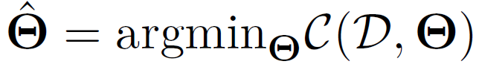
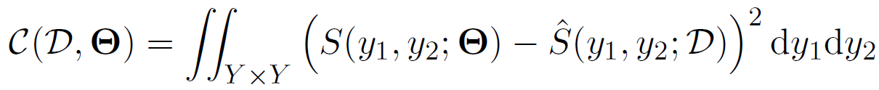
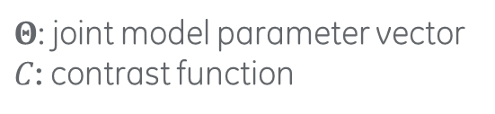


Classical MPP parameter inference approach
Minimum contrast estimator
$Θ$: joint model parameter vector
$C$: contrast function
Often
Analytical 2nd order statistics
(f.e. pair-correlation function)
Empirically measured conter-part of $S$
Challenges
$S$ necessitates a priori model
Analytical derivation of $S$: difficult when MPP is complex
Notes:
There are classical inference methods that may not necessitate the knowledge of the ellipsoid centers.
One of the method is referred to as the minimum contrast estimator. Where the parameters are estimated by minimizing a contrast function. Often, the contrast function is defined as the integrated sum of two parts. S, which is usually some analytical 2nd order statistics that does not necessitate the ellipsoid center. S-hat, which is the empirically measured counterpart of S.
The minimum contrast estimator however has challenges. First, in order to define S, we need to assume the model type, which can be non-trivial. Secondly, the analytical derivation of S can be challenging when the underlying model is complex.

Slide 9

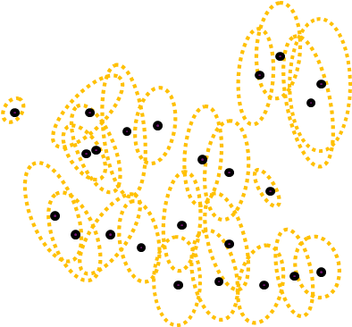

Inference from reconstruction
Two-step approach
Reconstruction step: simulate ellipsoidal approximation
Inference step: using reconstructed ellipsoids
Advantages
Ellipsoid centers observable after reconstruction → facilitate inference
Reconstruted ellipsoid → intuitions to determine model type
Notes:
To alleviate these challenges, we look at another approach referred as the inference from reconstruction.
It is a two-step approach.
The 1st step is the reconstruction step. Where we sample a good ellipsoid approximation of the ground truth using stochastic sampling technique.
The second step is the inference step where we estimate the parameters from ellipsoids reconstructed in the first step.
The first advantage of this approach is that, the reconstruction step reveals the position of the ellipsoid centers, this can make the inference much easier.
Also, from reconstructed ellipsoids, we can perform analysis to gain intuitions on the model type.

Slide 10
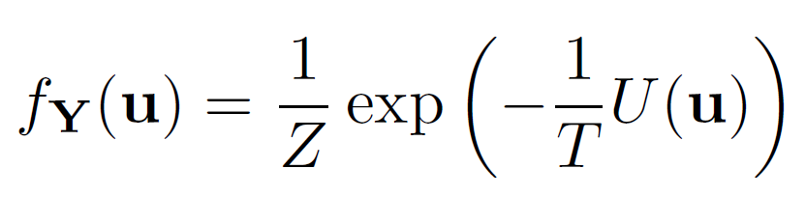
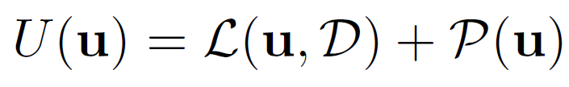
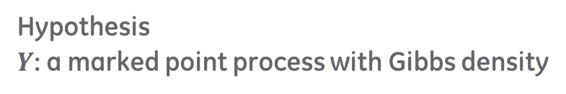

The reconstruction step
GOAL: find an optimal ellipsoidal approximation of input data
Hypothesis
$Y$: a marked point process with Gibbs density
With energy
The data term
How a configuration of ellipsoids deviates from input data
The prior term
Constraint on the overlap percentage btw ellipsoids
The optimal ellipsoidal configuration $u$*
Notes:
Let’s first look at the reconstruction step in detail. The goal is to find one optimal ellipsoid approximation of the input data.
We made the hypothesis that the underlying marked point process has a Gibbs density, with an energy term U.
The energy is decomposed into two terms.
The first terms L, measures how a configuration of ellipsoids deviates from the input data.
The second term P is the prior term. Where we put a constraint on the overlap ratio between ellipsoids.
With this formulation, the optimal ellipsoid configuration is the configuration that minimizes the energy term. Notice that this optimization is difficult to solve analytically. To tackle this problem, one popular method is to use Monte Carlo dynamic algorithms.

Slide 11
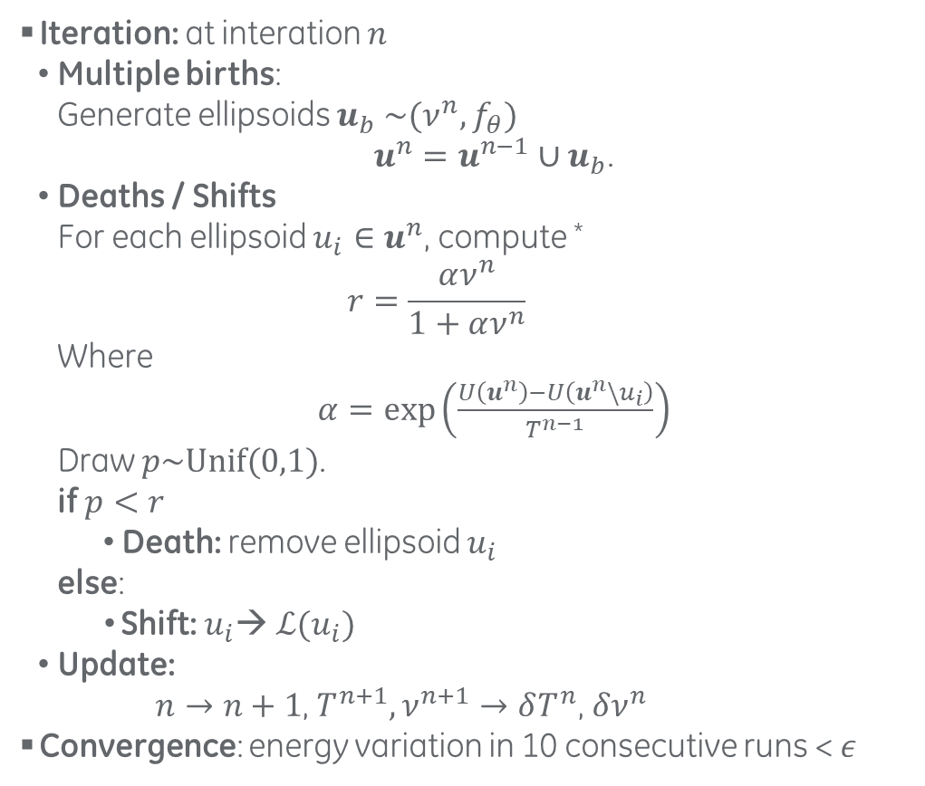
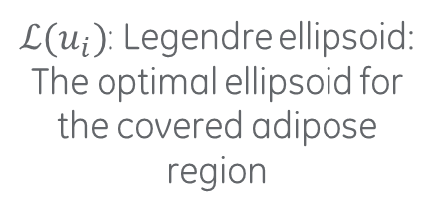
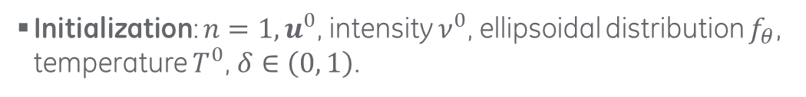
Multiple births, deaths & shifts
Initialization: $n=1,u^{0}$, intensity $ν^{0}$, ellipsoidal distribution $f_{θ}$, temperature $T^{0}$, $δ∈\left(0, 1\right)$.
Iteration: at interation $n$
Multiple births:
Generate ellipsoids $u_{b}$ ${\sim (ν^{n},f}_{θ})$
$u^{n}=u^{n−1}∪u_{b}$.
Deaths / Shifts
For each ellipsoid ${u_{i}∈u}^{n}$, compute *
$$r=\frac{αν^{n}}{1+αν^{n}}$$
Where
$α=\exp\left(\frac{U\left(u^{n}\right)−U\left(u^{n}\backslash u_{i}\right)}{T^{n−1}}\right)$
Draw $p\sim Unif(0,1)$.
if $p<r$
Death: remove ellipsoid $u_{i}$
else:
Shift: $u_{i}$→ $ℒ(u_{i})$
Update:
$n→n+1$, $T^{n+1},ν^{n+1}→δT^{n}$, $δν^{n}$
Convergence: energy variation in 10 consecutive runs < $ε$
$ℒ(u_{i})$: Legendre ellipsoid:
The optimal ellipsoid for the covered adipose region
* X. Descombes. Stochastic geometry for image analysis.
Notes:
To develop such an algorithm, we adopted an algorithm referred to as the multiple births, deaths and shifts.
We start with an initial configuration.
At a given iteration, we first perform multiple births, where random ellipsoids were generated.
Then we examine all the ellipsoids to determine either to remove it or to shift it. We do it by computing a probability term r, that depends on the energy contribution of the examined ellipsoid. With probability r, we decide to remove the ellipsoid. Otherwise, we will shift the ellipsoid.
To perform the shift. We first compute a new ellipsoid, referred to as the Legendre ellipsoid. It is defined as the optimal ellipsoid of the black region covered by the current ellipsoid. Then the shift is done by replacing the current ellipsoid with the Legendre ellipsoid.
In the end of each iteration we update the current configuration and parameters.
The final convergence was determined by looking at 10 consecutive iterations. If the energy variation during the 10 runs is smaller than a threshold, we stop the algorithm.

Slide 12
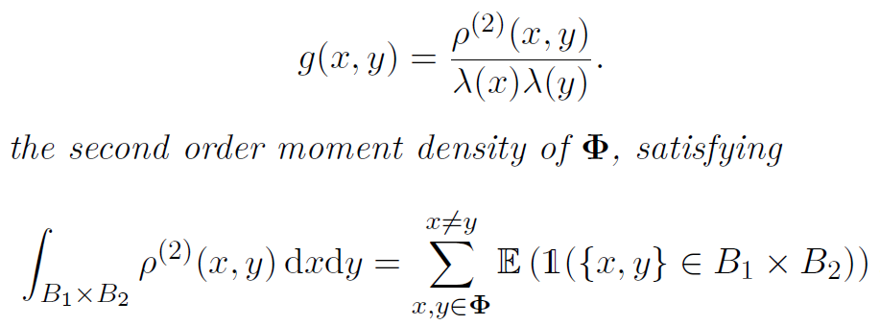
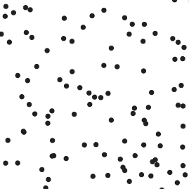
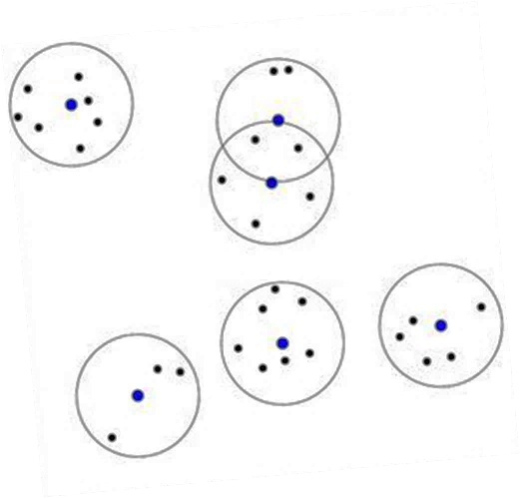
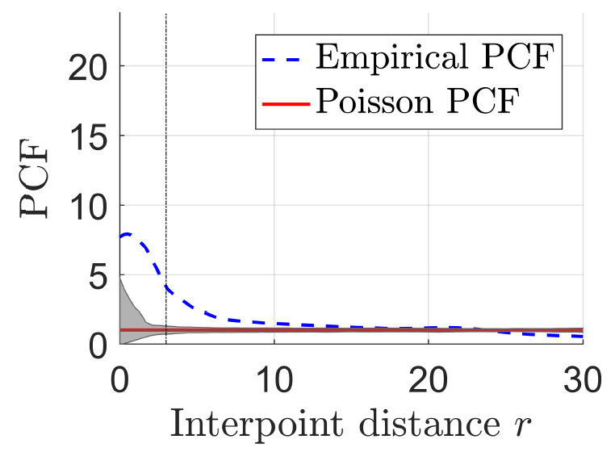
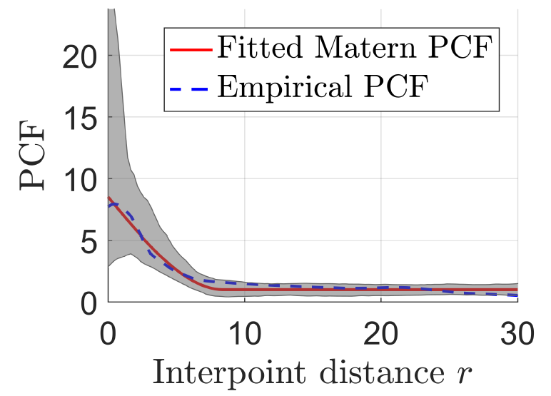
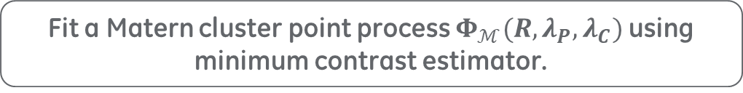
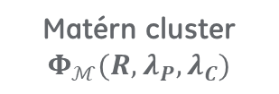
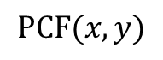
The inference step
GOAL: recon. ellipsoids → center point process, axis lengths & orientation
Reconstructed ellipsoids centers
Analysis of pair-correlation function (PCF)
$$PCF(x,y)$$
with
Stationary & isotropic process: $PCF\left(x,y\right)=PCF(r)$, $r=\left\|x−y\right\|$
Poisson
Matérn cluster $Φ_{ℳ}(R,λ_{P},λ_{C})$
PCF
PCF
1
1
r
r
Cluster
Fit a Matern cluster point process $Φ_{ℳ}(R,λ_{P},λ_{C})$using minimum contrast estimator.
Notes:
Next, the inference step. The goal of this step is to infer the center point process and ellipsoid parameters from reconstructed ellipsoids.
For the ellipsoid centers, we performed an analysis of the pair correlation function, or the PCF. The PCF is a second order statistics of point processes. It measures the probability density of having a pair of points located at two locations. For a stationary and isotropic point process, the PCF depends on the distance r between pair of points.
The PCF can reveal important distributional information of point processes. For the Poisson point process, the points are independently distributed, the PCF is constant equal to 1 in average. For a point process with cluster effects, the PCF is greater than one for some range. Here is an example of a Matérn cluster process. It is constructed by first sampling randomly positioned spheres with radius R, then generating Poisson point process inside each sphere.
By analyzing the empirical PCF of the reconstructed ellipsoid centers, we found that almost all the reconstructed ellipsoid configurations exhibit a clustering effect. This can be seen if we look at the PCF graph on the left, for a range distance values, the PCF is greater than 1.
Therefore, performed a fit of the reconstructed ellipsoid centers to the Matérn cluster process using the minimum contrast estimator. The graph on the right shows the fitted Matérn process PCF in comparison with the empirical PCF. We can see that the two PCFs match well, meaning that the fit was good.

Slide 13
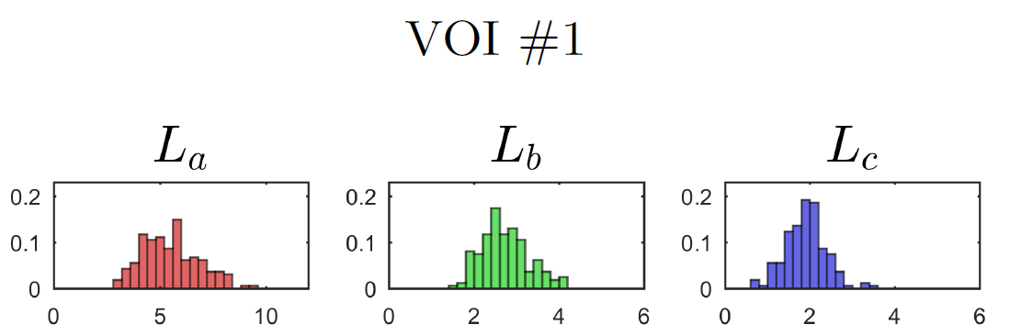
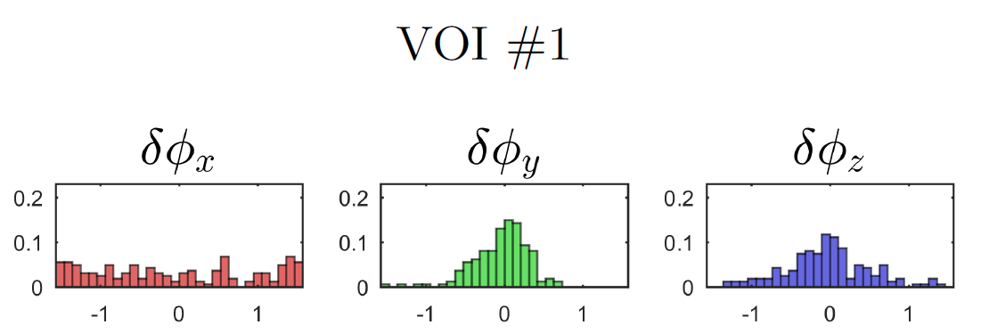
The inference step
GOAL: recon. ellipsoids → center point process, axis lengths & orientation
Reconstructed ellipsoids axis lengths & orientation angles
Analysis of empirical histograms
Axis lengths
Gaussian
Gaussian
Gaussian
Orientation angles
Uniform
Gaussian
Gaussian
Fitted to Gaussian / Uniform distributions using maximum likelihood estimator
Notes:
Regarding the ellipsoid axis lengths and orientation angles, we performed analyses of their empirical histograms.
Statistical tests were performed, showing that the distribution of these parameters can be modeled using either Gaussian or uniform distributions. This allowed us to fit these model parameters to either Gaussian or uniform distributions using the maximum likelihood method.

Slide 14
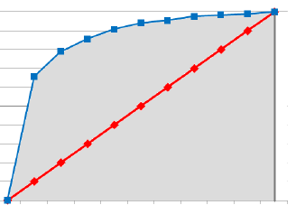






Model observer for lesion detection task
Image $g$
Decision variable
$λ=f($ images, template, internal noise $)$
Threshold
Decision outcome $D$
Figure-of -merit
Threshold
$$p$$
Decision function $f$
→ Decision variable $λ$: observer’s confidence of lesion presence.
Linear observer
$$λ=w^{T}g$$
$w$: template
Lesion
absent
Lesion
present
Decision Variable $λ$
Area under the ROC curve (AUC)
Notes:
The second part of this thesis is to develop a new model observer for 2D & 3D breast imaging based on the a contrario theory.
For a lesion detection task, a model observer is defined by a decision function f, which returns a decision variable lambda, indicating the observer’s confidence level of the lesion presence in image g. For example, with linear observers, lambda is computed as the inner product of a template w and the input mage g.
Then, different thresholding techniques can be applied to observer’s lambda values. This allows to further deduce a metric as the figure-of-merit for the detection task. For example, one commonly used figure-of-merit in binary classification tasks is the area under the receiver operator characteristics curve.

Slide 15


















Channelized Hotelling observer
CHO: one of the state-of-the-art for linear model observers
Based on linear discriminant analysis
Extendible to 3D volumetric & multi-slice cases
Training phase: compute template $w_{CHO}$
Lesion-present images
$$g_{1}^{(n)}$$
$$T$$
$$g_{1}^{(i)}$$
$$v_{1}^{(i)}$$
◉
Lesion estimate
$${\overline{v}}_{s}={\overline{v}}_{1}−{\overline{v}}_{0}$$
Lesion-absent images
Covariance estimate
$$K_{CHO}=\frac{1}{2}\left(K_{v_{0}}+K_{v_{1}}\right)$$
$$g_{0}^{(n)}$$
$$T$$
$$w_{CHO}=TK_{CHO}^{−1}{\hat{v}}_{s}$$
$$g_{0}^{(i)}$$
$$v_{0}^{(i)}$$
◉
Test phase: compute decision variable $λ$
$m$ test images
$$g^{(m)}$$
$$g^{(j)}$$
$$< ∙ >$$
$$λ^{(j)}$$
Myers et al. “Addition of a channel mechanism to the ideal observer model”. JOSA (1987)
Platiša, L. et al. “Channelized Hotelling observers for the assessment of volumetric imaging data sets”. JOSA. (2009)
Notes:
The channelized Hotelling observer, or CHO, it is one of the state of the art for linear observers. It is based on linear discriminant analysis and it can be extended to 3D cases. It takes into account information from the lesion and the background texture.
The CHO consists in two phases.
The first training phase aims to compute the template w_cho.
We start by computing the inner product of an input image with a set of channels. This is referred to as the channelization process.
It transforms the input image into a feature vector, and can reduce the dimension of the input image.
The channelization process is performed for both lesion present and absent images, referred to as the training sets.
After the channelization, the lesion is estimated as the difference between the lesion-present and absent vectors. The covariance is estimated as the average of the covariance of lesion-present and absent vectors. Finally, the template w_cho is expressed as the product of the channels, the estimated lesion and the inverse of the covariance matrix. Notice that the division by the covariance matrix acts as a decorrelation or whitening step of the input images.
The second phase is the test phase, it has the objective to compute the final CHO decision variable for a given image. Given an input image g. We compute the inner product of the image with the template obtained from the training step. This yields the final decision variable for that image.

Slide 16






Simulation of test objects
Breast phantoms (5x5x5cm³, 400 per category)
Uniform (gland. density 37%)
Scattered fibroglandular dense (gland. density 27% ± 2%)
Heterogeneously dense (gland. density 55% ± 2%)
Mesh-based.
Gland. density ≈ average density of textured volumes
Voxel-based 3D stochastic solid breast texture model *
Voxel resolution: 100µm
Microcalcifications
Mesh-based, approximately round shape
One µcalc per volume at breast volume center
4 diameters, 3 attenuations (% wrt Al at 22 keV)
50 µcalcs per condition
100 µm
200 µm
400 µm
600 µm
Li. et al. “A novel 3D stochastic solid breast texture model for x-ray breast imaging”. IWDM, 2016.
Notes:
Breast phantoms with both uniform and textured backgrounds were considered in this study. 400 5 x 5 x 5 centimeter cubed phantom volumes were simulated per background type. The uniform phantoms are mesh-based objects where the glandular density was set to be about the average of the density of textured phantoms. Two types of textured phantoms were considered: namely the scattered fibroglandular dense and the heterogeneously dense phantoms. They were simulated by sampling from our previously described voxel based 3D stochastic solid breast texture model. The voxel size was set to be 100 micron-meter.
Micro-calcifications were simulated as mesh-based objects of approximately round shape. One microcalcification was allowed to be present in each phantom volume and was inserted at the center. 4 microcalcification diameters and 3 microcalcification attenuation characteristics were considered. A bank of 50 microcalcification realizations were simulated per condition.

Slide 17






Simulated images
400µm µcalcs highest attenuation
FFDM
2.5cm
DBT central slice
Scattered fibroglandular dense
Heterogeneously dense
Uniform
Notes:
Here are examples of simulated FFDM images and DBT reconstructed central slices for three types of backgrounds use in our experiment. Here we show you images with 400um ucalcs at the highest attenuation. The ucalcs can be clearly observed at the center of the images.

Slide 18
Conclusion & discussion
A complete VCT experiment to compare µcalc detectability in FFDM vs DBT
Consistent results obtained
Performance of CHO increases with µcalc size at given attenuation.
Performance of CHO increases with µcalc attenuation at given size.
CHO and human seem to be linearly correlated
Under our nominal system modeling: DBT tends to outperform FFDM in µcalc detectability
Future steps
Investigate training sample size on CHO template estimation stability
Investigate more realistic & variable µcalc morphology & appearance
Investigate more realistic imaging system modeling
Notes:
In this study, we implemented a complete VCT experiment to compare µcalc detectability in FFDM vs DBT. Some consistent results were obtained: Performance of CHO increases with µcalc size at given attenuation. Performance of CHO increases with µcalc attenuation at given size. CHO and human seem to be linearly correlated. And Under our nominal system modeling: DBT tends to outperform FFDM in µcalc detectability.
Some future steps are necessary to further refine our study and interpret our results.
First, we used 200 pairs of microcalcification present and absent data for CHO training. Further analysis is needed to investigate whether this sample size is sufficient to allow for a stable estimation of the CHO template.
Secondly, we considered round μcalcs appearing in-focus in DBT reconstructed slices. In clinical reality, the morphological variability of the μcalcs is much larger and μcalcs do not always appear in-focus. Further investigation is required to understand their impact on μcalc detection performance.
Finally, a point source was used in our simulation and only primary x rays and quantum noise were modeled. The impact of x-ray scattering and electronic noise were not studied. Further evaluation and validation on a real imaging system are worthwhile to explore.
Despite the limitations of this study, this VCT experiment demonstrates the potential of using digital models for the implementation of more elaborated VCT experiments in the future.

Slide 19
Public mammography datasets
Database | Origin | # of images | Format | Annotation | Accessibility
MIAS | UK | 322 | Digitalized film | Circles | Immediate
DDSM | US | 10k | Digitalized film | Pixel locations & descriptions | Immediate
DDSM (curated) | US | 3k | Digitalized film | Pixel locations & descriptions | Immediate
DREAM | US | 500 | FFDM (Hologic) | Cancer / normal labels | Immediate
INBreast | Portugal | 400 | FFDM (Siemens) | Pixel locations & descriptions | Contact needed
OPTIMAM | UK | 17k | FFDM (Hologic) | Rectangles | Contact needed
Access to large-scale curated mammography database required & critical

Slide 20




Film vs digital mammogram
Auto W/L
ROI size ≈ 2.5 x 2.5 cm²
Film mammogram
Digital mammogram

Slide 21




2-stage training pipeline in detail
Deep Residual Network (ResNet *)
DDSM pre-training stage
5-class classification
Skip connection: addition of feature maps
GAP
Global average pool: each feature map → its average
Conv + BN+ Relu
Pooling
Fully connected
Background
DDSM ROIs
Conv Block
Conv Block
Conv Block
Benign calc
…
GAP
Malignant calc
Benign mass
Malignant mass
DREAM fine-tuning stage
Binary classification
Flat
Flattening: feature maps → 1 vector
Flat
Freezed
Trainable
Conv + BN+ Relu
Pooling
Conv + BN+ Relu
Conv + BN+ Relu
Fully connected
Conv Block
Conv Block
Conv Block
Flat
Cancer
DREAM FFDM
…
vs
GAP
Normal
Transferred
Compare w/ vs w/o GAP
2 New layers
* He et al., 2016, Identity Mappings in Deep Residual Networks

Slide 22
Densely connected convolutional networks (DenseNet *)
Dense Block
Dense Block
Dense Block
Background
Benign calc
Malignant calc
Benign mass
Malignant mass
Initial conv
Conv(7 x 7/2), MaxPool (3 x 3/2)
Composite
BN, ReLU, Conv(1 x1/1), BN, ReLU, Conv(3 x 3/1)
Transition
Conv(1 x 1/1), AvgPool (2 x 2/2)
Classification
GlobalAvgPool, FC
Parameter Symbol Note
# blocks $n_{b}$ # of dense blocks
Block size $b$ # of composite layers in dense block
# init $n_{0}$ # of output feature maps from the 1st conv
Init kernel size $s_{0}$ Kernel size of the 1st conv layer
Growth rate $k$ # of output feature maps from each composite layer
Bottleneck ratio $m$ # of output feature maps from Conv(1 x 1) in composite layer = $m∙k$
Compression $c$ Ratio btw # of output & input feature maps of a transition layer
Dropout ratio $p_{d}$ Proportion of output neurons to be set to 0 after each dense block
* Huang et al., 2017, Densely connected convolutional networks

Slide 23








Performance evaluation
Qualitative metric
Class activation map (heatmap) *:
Coarse indicator of localization capacity of a classification network
Classification for class $i$
Heatmap for class $i$
Network w/ GAP*
Conv Block
Class $i$ score
…
$$∙$$
…
…
GAP
…
…
$$+$$
$$+$$
$$+$$
*
*
*
Last feature maps
Class $i$ FC weights
Heatmap
Input
Network w/o GAP
Conv Block
Class $i$ score
…
$$∙$$
…
…
⊙
$$+$$
⊙
$$+$$
…
$$+$$
⊙
Last feature maps
Class $i$ FC weights
Heatmap
Input
* Zhou et al., 2015, Learning Deep Features for Discriminative Localization

Slide 24
Pre-training stage set-up
Data distribution (training / validation 75% / 25% split)
 | Benign calc | Malignant calc | Benign mass | Malignant mass | Normal | Total
Training | 787 | 282 | 641 | 532 | 800 | 3042
Validation | 196 | 70 | 133 | 200 | 200 | 759
% in total | 25.9% | 9.3% | 21.1% | 17.5% | 26.3%
Preprocessing
ROI size: 600 x 600 pixels (~2.7 x 2.7 cm²) → resized to 400 x 400 (memory constraint)
Pixel values rescaled to (0, 1)
Histogram equalization applied (slightly improves contrast)
Network configuration
34-layer ResNet (tensorflow.keras)
Batch size = 32
Learning rate = 10⁻³ w/ exponential learning rate decay
Last layer 50% dropout & data augmentation (flipping & rotation on-the-fly)

Slide 25
Fine-tuning stage set-up
Data distribution
Class | Number (%)
Cancer | 34 (6.8%)
Normal | 466 (93.2%)
Class | Number - train | Number - validation
Cancer | 510 | 170
Normal | 510 | 170
Initial distribution
After augmentation & 75% / 25% train / valid split
Preprocessing
Augmentation: flipping (up/down, left/right) & rotation (±5º, ±10º),
Original size 2560 x 3328 pixels → resized to 886 x 1152 (memory constraint)
Pixel values rescaled to (0, 1)
Network configuration
Pre-trained 34-layer ResNet (conv layers) + 2 new convolutional layers
Batch size = 10
Learning rate = 10⁻⁵ w/ exponential learning rate decay
Last layer 50% dropout & weight decay w/ strength 10⁻⁴

Slide 26










Generative adversarial network (GAN *)
Goal:
Given training images $\{x\}$, train neural network to transform noise image ${z\sim p}_{z}$ to $\hat{x}$ looking like images from $\{x\}$
Two neural networks $G$and $D$playing min-max game
Generator $G$: transforms noise images $z\sim p_{z}$ to fake images
Discriminator $D$: classifier whether an image is real or fake (value btw 0 and 1)
Equilibrium condition: $D$ outputs 0.5
Generated target $\hat{x}$
$$z\sim p_{z}$$
or
Probability of real target
Generator $G$
Discriminator $D$
Real target $x$
$$\min_{G}{\max_{D}{L\left(D,G\right)=E_{p_{data}}\left(\log{D(x)}\right)}}+E_{p_{z}}\left(\log\left(1−D\left(G\left(z\right)\right)\right)\right)$$
GAN loss
Log-likelihood: $D$ correctly predicting real images
Log-likelihood: $D$ correctly predicting fake images
* 2014, Goodfellow et al., Generative adversarial nets (https://ge.box.com/s/qb81gi4ytkvw1hj9gew8jg0y66y4o5gp)

Slide 27





GAN with additional loss
Penalize diff. btw source and generated target
Real source $z$
Generated target $\hat{x}$
Generator $G$
or
Probability of real target
Discriminator $D$
Loss penalizing diff. btw source & generate target
Perceptual loss
Real target $x$
$$L\left(D,G\right)=L_{a}+E_{p_{data}}\left(\log{D(x)}\right) +E_{p_{z}}\left(\log\left(1−D\left(G\left(z\right)\right)\right)\right)+L_{d}$$
Additional loss for lesion detectability
Advantages | Drawbacks
Paired images not needed Improved content preservation vs original GAN | TBD

Slide 28










Conditional GAN
Penalize diff. btw source and generated target
Real source $z$
Generated target $\hat{x}$
Real target $x_{\left(2\right)}$
Generator $G$
or
Probability of a pair with real source & real target
Copy
Discriminator $D$
Real target $x$
Real source $z$
Real source $z_{\left(2\right)}$
$$L\left(D,G\right)=E_{p_{data}}\left(\log{D(x,z)}\right) +E_{p_{z}}\left(\log\left(1−D\left(G\left(x,z\right)\right)\right)\right)+L_{d}$$
Additional loss for lesion detectability
Advantages | Drawbacks
Improved content preservation vs original GAN | Paired images needed

Slide 29


















CycleGAN
Incorporate cycle consistency to enforce realism of
Generated target images wrt real images & regenerated source images wrt real source images
Regen src ${\hat{z}}_{1}$
Real src $z_{1}$
Gen targ ${\hat{x}}_{1}$
Real targ $x_{1}$
Generator $G$
Discriminator $D_{G}$
Similarity loss $L_{s_{1}}$
or
Probability of real source
Probability of real target
or
Similarity loss $L_{s_{2}}$
Discriminator $D_{F}$
Generator $F$
Real src $z_{2}$
Gen src ${\hat{z}}_{2}$
Real targ $x_{2}$
Regen targ ${\hat{x}}_{2}$
$L\left(G,F,D_{G},D_{F}\right)=L\left(G,D_{G} \right) +L\left(F, D_{F}\right)+L_{s_{1}}+L_{s_{2}}+L_{d_{G}}$+ $L_{d_{F}}$
Additional lesion detectability loss for both generators
Advantages | Drawbacks
Paired images not needed Improved content preservation vs original GAN | Training complexity

Slide 30







Simulation results using inferred parameters
Volume slices
Mammograms
DBT recon. slices
Almost entirely adipose
Scattered fibro-glandular dense
Heterogeneously dense
Heterogeneously dense
Image size:
3.5 cm x 3.5 cm
Notes:
Here is a slice from a volume simulated from the model representing an adipose breast. Here is the mammogram created from the same volume. And here is the DBT reconstructed slice created from the same volume. Here we also have other three sets of simulations representing three breasts with different densities.
The simulated images exhibit high visual realism. Also, we notice the improved morphological variation in simulated images. This is can be mainly attributed to the newly inferred medium scale parameters.

